Slide 1




HACKAHOLICS
HACKTOBERFEST 1.0

Slide 2






Problem statement
SPEARS TRAVEL aims to boost customer satisfaction by delivering personalized travel plans. The current method relies on manual planning, restricting customization and efficiency. The agency is in search of a solution to automate the travel itinerary planning process and provide tailored recommendations aligned with customer preferences and limitations.
THE PROBLEM IS IMPORTANT AND RELEVANT TO CUSTOMERS DUE TO FOLLOWING REASONS:
1.HELPS IN BUDGETING 2. SAVES TIME 3.MAXIMISES EXPERIENCE 4.KNOWS WHAT TO EXPECT
5. STRETCHES DOLLAR
29% of bookers prefer direct travel reservations for various reasons, including:
Ask for extra amenities (28%)
Get the best price (21%)
Avail of loyalty programs (21%)
Negotiate better prices (18%)
Find direct booking benefits (11%)

Slide 3




Solution
Our innovative business strategy combines profit-making with social impact to create a sustainable solution for the tech industry. Strategy Overview: SPEARS Travelsis a travel agency catering exclusively to the tech industry, offering sustainable and socially responsible travel solutions. Solutions we are providing: 1. Sustainability-Centric Travel Options 2. Personalized Travel Experiences 3. Transparency and Reporting 4. Continuous Improvement

Slide 4


Key Features and Functionality
AVAILABILITY OF LOGIN AND SIGNUP USING CREDENTIALS AND EMAIL VERIFICATION: PREVENTS FABRICATED PROFILES
USER-FRIENDLY INTERFACE WITH INTUITIVE NAVIGATION AND AI CHAT BOT.
PROVISION OF 5 LANGUAGE SUPPORT.
24 AVAILABLE CHAT BOT FOR BETTER USER EXPERIENCE.

Slide 5


Social impact
The social impact of agency on customers include fostering cultural understanding, encouraging responsible travel behavior, and supporting local communities through eco-friendly and socially responsible travel options.
WAYS TO MEASURE AND TRACK YOUR SOCIAL IMPACT: Customer surveys and feedback
Economic impact on local communities
Behavioral changes in clients +
Charitable contributions and initiatives
Safety and crisis response effectiveness
Inclusivity metrics (e.g., accessibility)
Client stories and testimonials
Regular monitoring and reporting of impact.

Slide 6

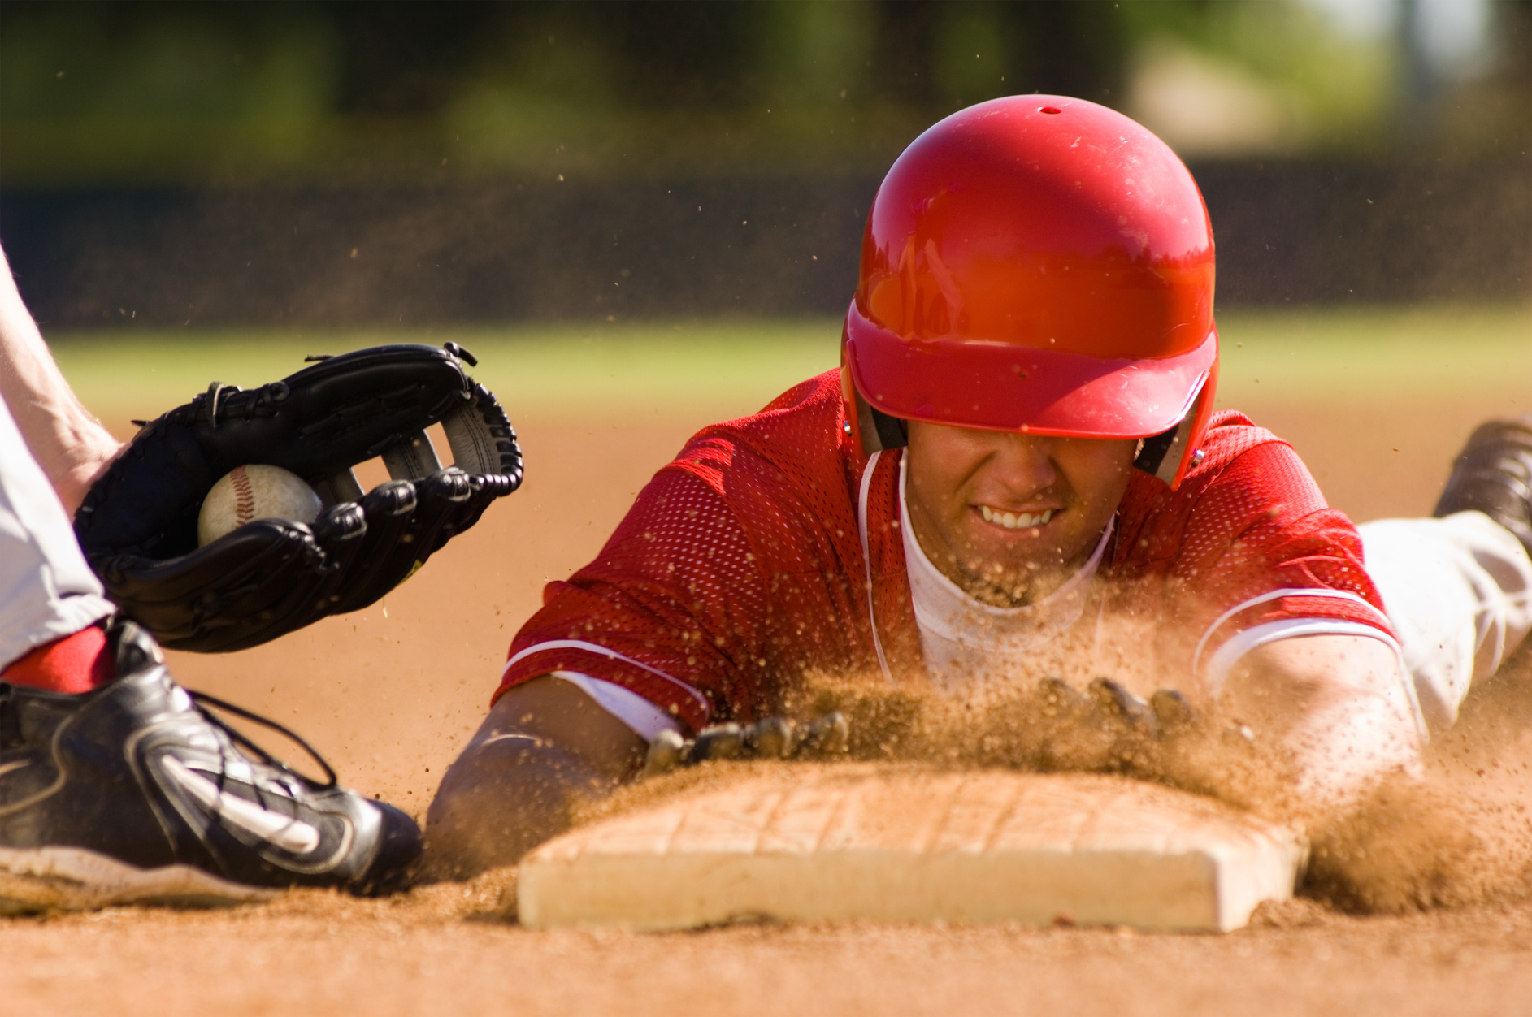
Revenue Model
REVENUE is pitched via Verified hotels and restaurants employed using promotions and commissions. Spears Travel creates value for society by fostering cultural understanding, supporting local communities, promoting sustainability, and providing access to education. By offering responsible travel experiences, the agency contributes to a better world with improved cultural appreciation, economic development, environmental protection, and enhanced opportunities for all.

Slide 7



Technologies Used
OUR TEAM UTILIZED A VARIETY OF TECHNOLOGIES INCLUDING PROGRAMMING LANGUAGES LIKE FIGMA ,REACT JS, GOOGLE SHEETS, ZAPIER ,APPSHEETSAND BOTPRESS AS WELL AS TOOLS LIKE GITHUB AND AWS.

Slide 8




The Team
VIKRANT MALIK
KASHISH
PRASHANT SHARMA
AI DEVELOPER
WEBSITE DEVELOPER
WEBSITE DEVELOPER

Slide 9


Thank You
HACKTOBER FEST

